Slide 1
Introduction To Asp.Net Core
PRESENTER: MOHAMMAD ADIL

Slide 2
Introduction
Nowadays, everyone is talking about open source, cross platform development. Microsoft has always been known for its Windows based products, but now we are in the new age of development. For this, a new revolutionary product came into the market, which is Microsoft .NET Core.
NET Core is a free open source and cross platform framework, created for building modern Cloud based Applications and every .NET developer feels proud of it. Now, there are no boundaries for the platform. Now, every .NET developer can say, yes I am platform independent, I am using an open source.

Slide 3
Introduction
In the revolution of software development, Microsoft launched its first .NET framework in the year 2000 with its first .NET framework 1.0. This framework plays a major role in the field of software development. People love Microsoft technology products, because these products are easy to use and easy to learn.
In the year 2016, Microsoft has come up with a new revolution, Microsoft .NET Core 1.0. People always love ASP.NET, because it's working over WorldWideWeb.
ASP.NET Core is a new open source, cross platform framework to create modern Web based Cloud based systems, which means, now you are not only working for Windows, you can run in Linux, Mac; i.e., wherever you want.

Slide 4
Open Source Means
In general, open source refers to any program whose source code is made available for use or modification as users or other developers see fit. Open source software is usually developed as a public collaboration and made freely available.
The software being distributed must be redistributed to anyone else without any restriction.
The source code must be made available (so that the receiving party will be able to improve or modify it).

Slide 5
ASP.NET Core features
Cross platform, open source now runs your app over Linux, Windows, Mac; i.e., wherever you want.
Fast Development- fast work over the Browsers.
Work in your editors - now you can work not only in Visual Studio. You can also choose Visual Studio code

Slide 6
Introduction
.NET framework includes
ASP.NET 4.6 (System.web)
Web Forms
MVC
Web API
WPF, WCF
Windows Form Application
.NET framework is known for Windows platform.

Slide 7
Introduction
.Net Core comes with
ASP.NET Core MVC
Universal Windows App.

Slide 8
DIFFERENCE
.NET FRAMEWORK
.NET CORE FRAMEWORK
OLD FRAMEWORK
NOT OPEN SOURCE
ONLY FOR WINDOWS PLATFORM
NEW FRAMEWORK
OPEN SOURCE
CROSS PLATFORM (WINDOWS, LINUX, MAC)

Slide 9
DIFFERENCE
ASP.NET
ASP.NET CORE
Targets .Net framework
All components are available like asp.Net mvc, web api, asp.Net webforms etc
Targets .Net core framework
Asp.Net webforms are not there in asp.Net core, we have asp.Net mvc core and web api in .Net core.

Slide 10
History of ASP.NET
ASP.NET has been used from many years to develop web applications. Since then, the framework went through a steady evolutionary change and finally led us to its most recent descendant ASP.NET Core 1.0.
ASP.NET Core 1.0 is not a continuation of ASP.NET 4.6.
It is a whole new framework, a side-by-side project which happily lives alongside everything else we know.
It is an actual re-write of the current ASP.NET 4.6 framework, but much smaller and a lot more modular.
Some people think that many things remain the same, but this is not entirely true. ASP.NET Core 1.0 is a big fundamental change to the ASP.NET landscape.

Slide 11
What is ASP.NET Core
ASP.NET Core is an open source and cloud-optimized web framework for developing modern web applications that can be developed and run on Windows, Linux and the Mac. It includes the MVC framework, which now combines the features of MVC and Web API into a single web programming framework.
ASP.NET Core apps can run on .NET Core or on the full .NET Framework.
It consists of modular components with minimal overhead, so you retain flexibility while constructing your solutions.

Slide 12
Pre-Requisite
HTML
CSS
Javascript, Jquery
Bootstrap (Optional)
C# Programming language.
MVC
Visual Studio 2017 or higher version
We use Visual Studio 2019 in this tutorial series.

Slide 13
Mvc With Asp.Net Core
PRESENTER: MOHAMMAD ADIL

Slide 14
Introduction to ASP.NET MVC
Three basic components of ASP.NET MVC:
Model (Business Entities)
View (Presentation Logic)
Controller (Business Logic)

Slide 15
Advantages of Separation of Concerns (SOC)
Allows work on individual pieces of the system in isolation
Facilitates reusability
Ensures the maintainability of a system
Ensures extensibility
Enables users to better understand the system

Slide 16
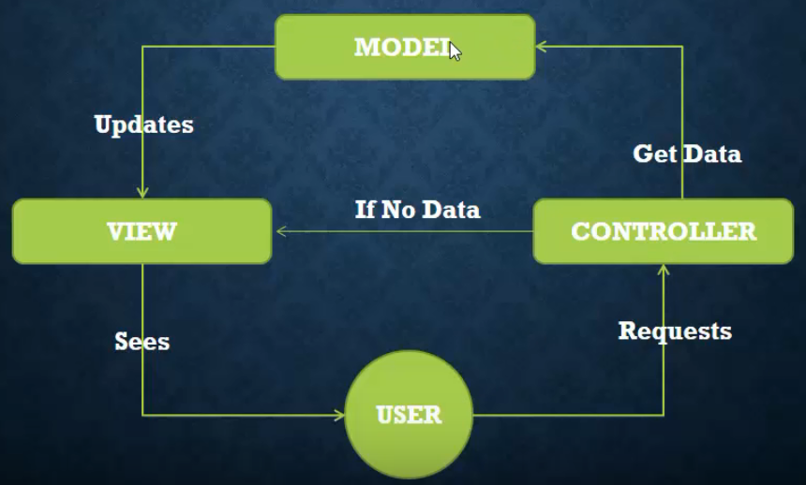
MVC WORKFLOW

Slide 17
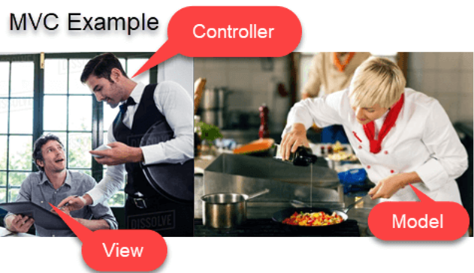
REAL LIFE EXAMPLE OF MVC

